Slide 1

Willow
Unlock the power of decentralized applications with our IPC-based Willow smart contract

Slide 2
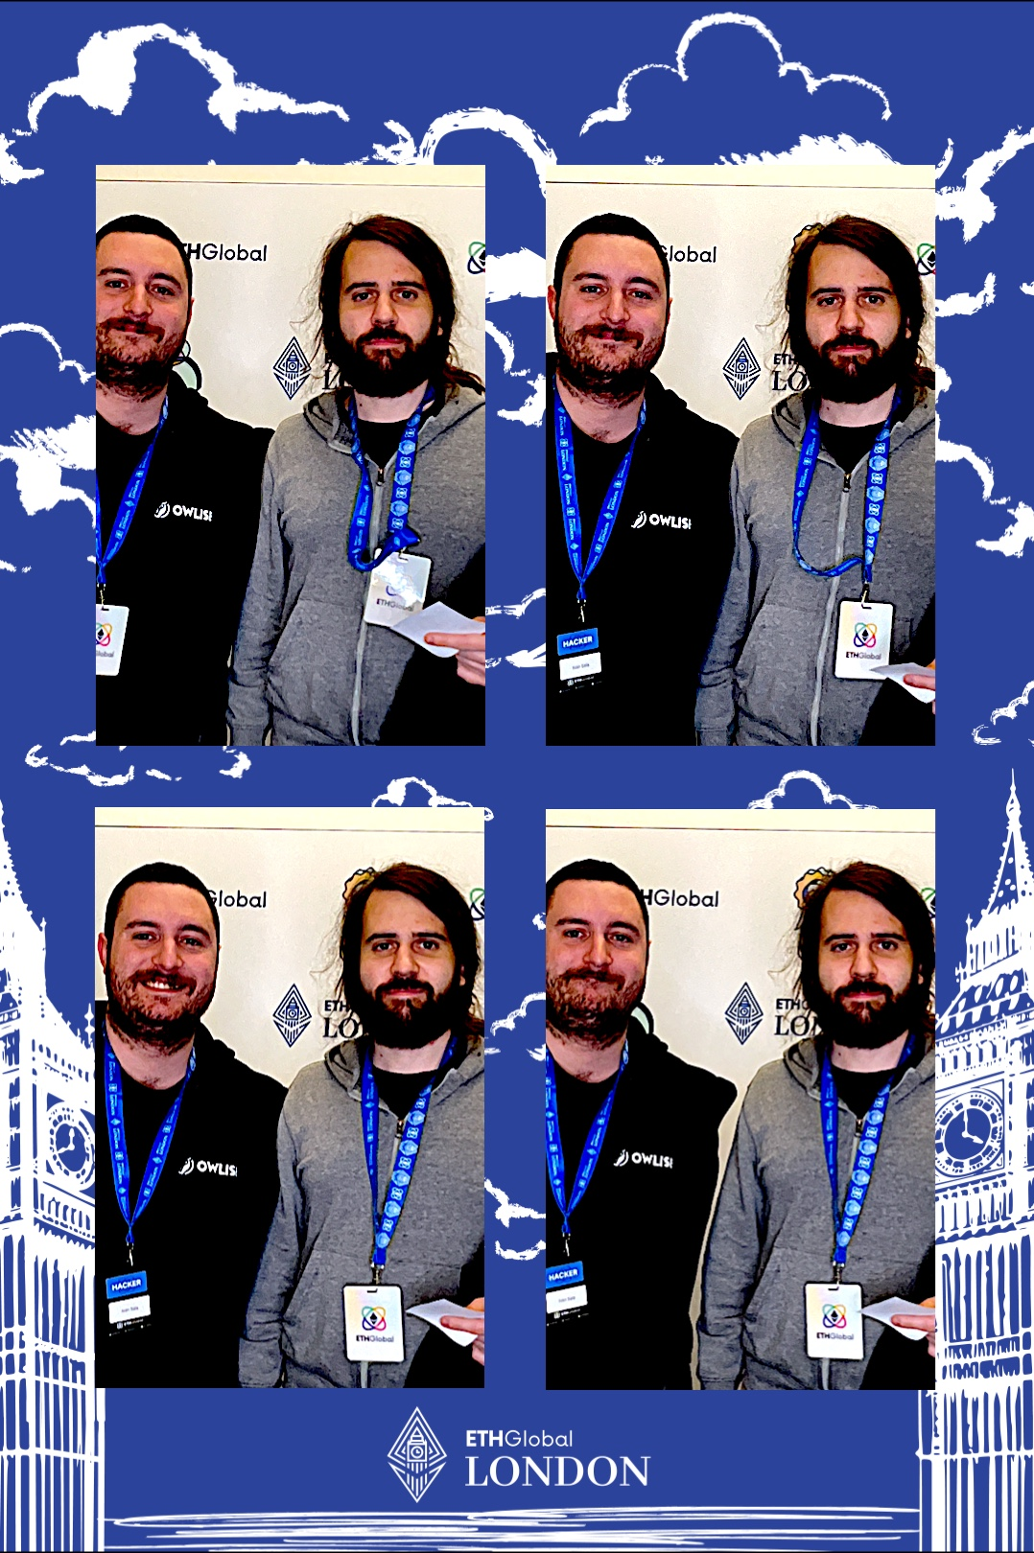
Who we are
Andrea Ciceri – Block producer Ivan Sala – Average EVM Enjoyer

Slide 3

Our project revolves around leveraging Interplanetary Consensus (IPC), a groundbreaking framework designed for scalable and versatile blockchain solutions. IPC introduces a novel approach to scalability by utilizing on-demand scaling through the deployment of customizable "subnets."
At the core of our implementation is the Willow smart contract library, which harnesses the power of IPC to enable direct access to content stored on the InterPlanetary File System (IPFS). By integrating IPC with Willow, we unlock new possibilities for extending the functionality of smart contracts, enhancing interoperability, and improving scalability in blockchain networks.

Slide 4

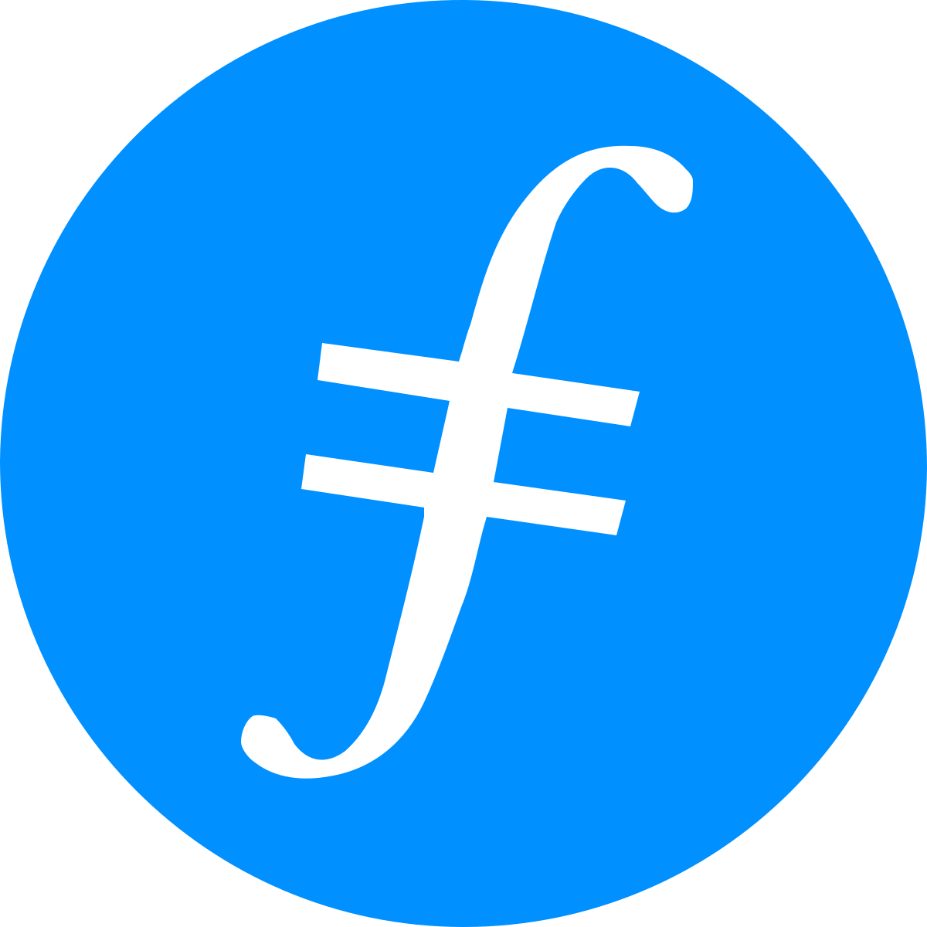

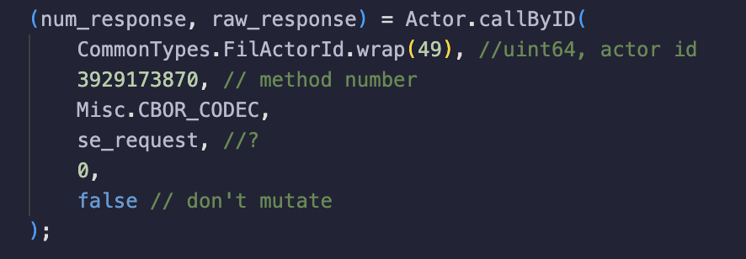
How it’s made

Slide 5
Issues
https://github.com/filecoin-project/fvm-specs/blob/main/08-syscalls.md 1) Each syscall takes zero or more i32 and i64 arguments and returns exactly one i32 indicating the final status of the syscall (the "error number").
https://github.com/filecoin-project/ref-fvm/blob/464bba53ad01391452db605002c9b5cca189fe39/fvm/src/syscalls/linker.rs#L48 2) The syscall parameters, are 0-8 types, each one of [`u32`], [`u64`], [`i32`], or [`i64`] and NOT a String
https://github.com/filecoin-project/filecoin-solidity/blob/274c56ee3ccdc9fb8e7dccc14e346864301ebd24/contracts/v0.8/MinerAPI.sol#L108 2) bytes memory raw_request = new bytes(0);
Understand how to pass to the actor the correct parameter https://github.com/filecoin-project/ref-fvm/blob/464bba53ad01391452db605002c9b5cca189fe39/shared/src/error/mod.rs#L91
4) Understand USR_ILLEGAL_ARGUMENT

Slide 6
Final result
1) We managed to start a local IPC subnet 2) We implemented a custom syscall that perform a GET of an IPFS content 3) Running the subnet we can see the IPFS content being accessed and the custom syscall being called 4) We developed a smart contract for calling and executing our custom syscall via a custom Actor 5) We deployed the smart contract inside our subnet
6) Calling the smart contract method «execute» we get an error (USR_ILLEGAL_ARGUMENT) To Do: 1) Understand how to fix the USR_ILLEGAL_ARGUMENT error
2) Generalize the type used from the syscall or access the WASM fvm memory using a pointer to return the IPFS content 3) Generalize the implementation 4) Improve the docs with what we have learnt!

